Slide 1
Design Patterns
Chapter 2

Slide 2
Question
Clients generally obtain information from objects of interest (the “subject”) by calling the subject’s methods
But how can the client keep current if the subject keeps changing?
  How do they know when to query the subject?

Slide 3
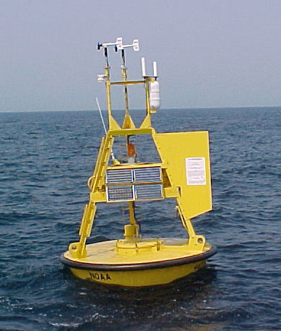
Weather-O-Rama
A weather station periodically measures temperature, humidity, and barometric pressure
A driver object is provided that monitors the station and calls a certain method at regular intervals with new data:
  void measurementsChanged( );
We need to write code that notifies observers
  And the type and number of observers can change!

Slide 4

Naïve Solution
Add code to measurementsChanged that notifies the observers
  There are three initially:
    Current conditions
    Statistics
    Forecast
See next slide

Slide 5
public void measurementsChanged() {
float temp = getTemperature();
float humidity = getHumidity();
float pressure = getPressure();
currentConditionsObserver.update(temp, humidity,
pressure);
statisticsObserver.update(temp, humidity,
pressure);
forecastObserver.update(temp, humidity,
pressure);
}
What potential design liabilities do you see?

Slide 6
Is this a Flexible Design?
Since we know upfront that the observers are not fixed, our design is inadequate
There is too much coupling between the Weather object and the observing devices
  As new devices are added, we’ll need to change the code in measurementsChanged
What principles of design should we observe?

Slide 7
Design Principles
“Program to an interface, not an implementation”
  Let’s create a common interface for our devices
    So WeatherObject doesn’t need to differentiate between concrete types
    We’ll have a collection of interface handles instead
This will allow us to:
  “Separate the aspects of our program that vary from what stays the same”

Slide 8
The Observer Pattern
Allows an object to be tracked (observed) by an arbitrary number of observers with a minimum of coupling
AKA “Publisher-Subscriber”
Think of newspapers or online alerts (like RSS feeds)
  You subscribe to get notifications
  You can unsubscribe at any time

Slide 9
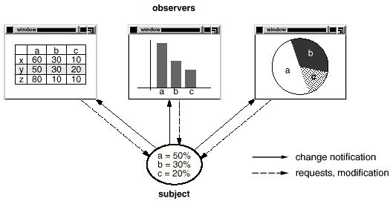

Slide 10
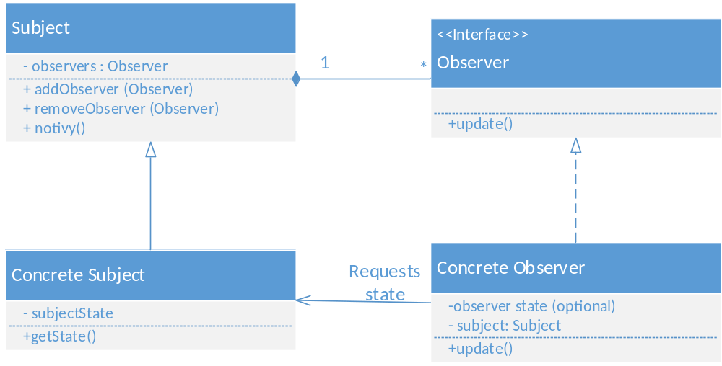
The Observer Pattern

Slide 11
Observers in GUIs
A GUI window contains views of some data
  The same data can have multiple views in use simultaneously
  The GUI also has control mechanisms (buttons, etc.)
The data should have no knowledge of its viewers (or that it even has any viewers!)
  But the views must somehow be updated as the data changes and/or as user events occur
  Our data will have minimal knowledge of observers (through an interface only)

Slide 12
Java Swing Example
A single button click will trigger two actions
The two actions “observe” the button
  They “listen” for a click
Swing has a Listener interface and a way to register a listener with a GUI widget
  The listener could update the view, or perform some other action (write to a file, etc.)
This is an implementation of Observer
  See next slide

Slide 13
// From file SwingObserverExample.java
JButton button = new JButton("Should I do it?");
// Here are the listeners (observers)
button.addActionListener(new ActionListener() {
public void actionPerformed(ActionEvent e) {
System.out.println("Don't do it, you might regret it!");
}
});
button.addActionListener(new ActionListener() {
public void actionPerformed(ActionEvent e) {
System.out.println("Come on, do it!");
}
});

Slide 14
The Observer Pattern
Advantages
Both sides are insulated form implementation details
  Details in concrete classes can vary independently
New observers can be added at will
Subject doesn’t change when new types of observers are created

Slide 15

Weather-O-Rama with Observer
How can we make the Weather Station take advantage of the Observer Pattern?
  (fill it in below…)

Slide 16
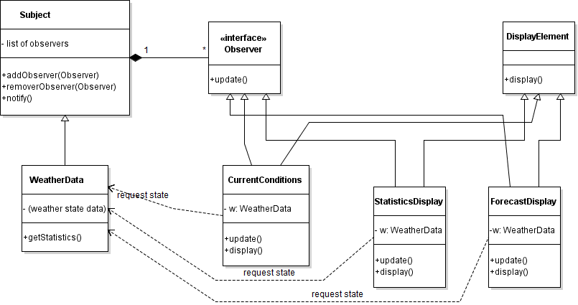
Weather Observer (using Violet)

Slide 17
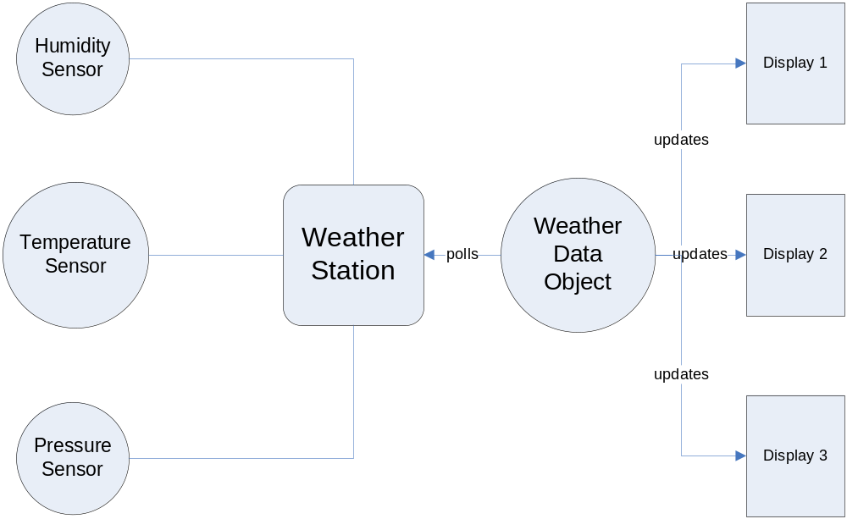

Slide 18
Implementation Notes
The Subject maintains a list of Observers
  Added when observers register
All observers are notified
  When?
  What about composite updates?
  What about threading issues?
Observers keep a reference to the subject
  So they can unsubscribe
    By calling subject.removeObserver(this)
  So they can query state

Slide 19
Notifying Observers
The notify method calls update for each observer
How should observers respond?
What about passing data to the observers?

Slide 20
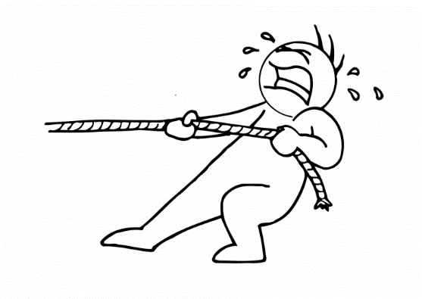
The Pull Model
The Subject just notifies the observers without passing any data
The Observers then call getter methods on the Subject for data
  Observers must know the interface for Subject
  Have to figure out what changed themselves

Slide 21
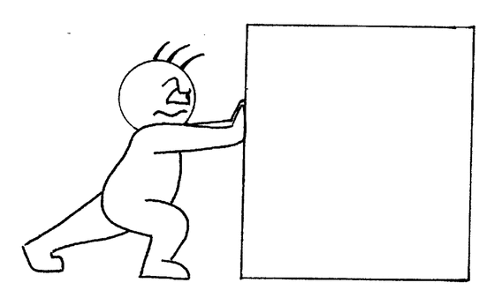
The Push Model
The Subject passes data in a parameter in update
  As a single instance of Object in Java
    For genericity
    Must use an explicit class or a template parameter in C++
Observers must know how to cast and/or interpret this data

Slide 22

Push vs. Pull
Advantages of each?
Disadvantages of each?

Slide 23
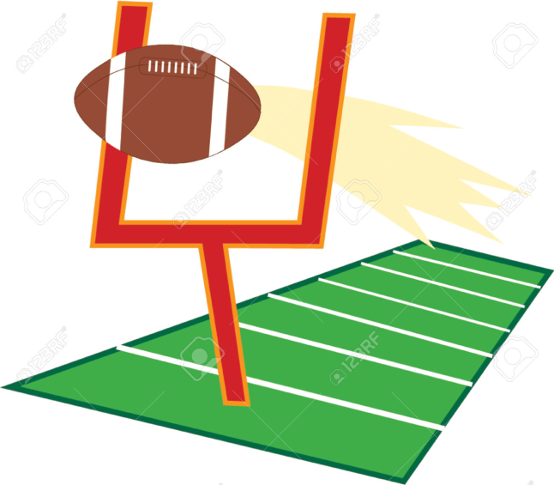
Let’s code a Football Game
Version 1: pull model
Version 2: push model – push data
    Simple but unsafe and hard to maintain
Version 3: push model – a data object
    Safer and easier to extend
Notes:
Version 2: ask “What changes to Version 1, 2 if you record penalty yards for each team?”
(version 2: you have to change the update() interface – what principles does that violate?)
Also ask it for version 3

Slide 24
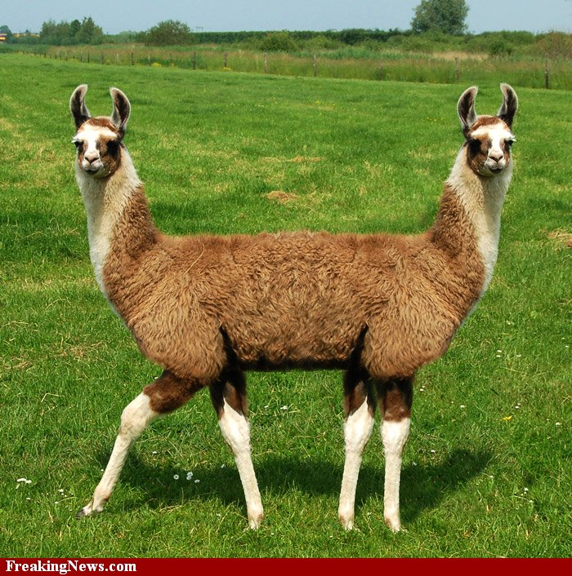
Hybrid Push-Pull???
Maybe the subject pushes a small amount of data
  Maybe something that says what changed
And observers can pull the data they want (or not)
Adapt it to your needs

Slide 25
Observers in the Wild
Seen in the wild:
  Model-View Controller software (very common!)
    (usually has just one observer)
  Distributed systems: observers and subject are all on different computers
  Maybe between GPU and CPU in a computer

Slide 26
Synchronous Observation
Subject and Observers are same process (same thread):
  When Subject does notify(), it waits until all observers have finished their update() processes.
  No synchronization issues
(Program 2 is like this)

Slide 27
Asynchronous Observation
Observers and Subject are on different threads, processes, and/or computers
This is common in the SAAS world
What are possible synchronization issues?

Slide 28
Out of sync update():
  Subject notify(), before Observer responds, the subject’s data has changed again (maybe another notify())
  May or may not matter

Slide 29
Out of sync register() or unregister():
  Either miss the first notify, or get an extra one after the Observer unregisters.
  Shouldn’t be a big deal, but you need to be able to handle it.

Slide 30
Observers in Threading
Multiple threads can compete for the same resource
  Sometimes all waiting threads need to be notified
  Sometimes only one thread needs notifying
  Java provides notify and notifyAll
Using notifyAll is an application of the Observer pattern

Slide 31
Java Implementation Notes
Java has a Observable class for subjects
  Provides add/remove/notify functionality
  But requires inheritance, so isn’t always usable
Java has an Observer interface for observers
Supports both Push and Pull

Slide 32
Design Issue
java.util.Observable is an abstract class
  Not an interface
  This is Good (why?)
How can I make a class that already extends another an Observable subject and still take advantage of Java’s Observable-Observer support?
Notes:
Have the subject hold a reference to an object that manages the observers. In other words: use composition.
You can also use Proxy or Mediator (will see later)

Slide 33
Design Principle
“Strive for loosely-coupled designs between objects that interact.”

Slide 34
Variations
Observers can observe multiple subjects
A subject can itself be an observer of another subject
If communication between subject and observers is complex, encapsulate in a ChangeManager object
  A type of Mediator

Slide 35
Another Variation
What if you want to observe an existing class without changing its code?
Notes:
You wrap it in another class. This requires a little thought. The wrapper will probably need to be able to “stand-in” for the subject transparently. See Proxy and Decorator.

Slide 36
Polling
An observer can constantly poll a subject for changes in state
  But it misses the point of Observer!
Or, a mediator object can do the polling and update any number of observers
  By calling their update method

Slide 37
Proxy
You could also have a Proxy class “stand-in” for the Subject.
  The Proxy implements the same interface as the Subject
  It also notifies Observers when the Subject changes

Slide 38
What is a Design Pattern?
“A design pattern systematically names, motivates, and explains a general design that addresses a recurring design problem in object-oriented systems. It describes the problem, the solution, when to apply the solution, and its consequences. It also gives implementation hints and examples. The solution is a general arrangement of objects and classes that solve the problem. The solution is customized and implemented to solve the problem in a particular context.”
(Gang of Four)

Slide 39
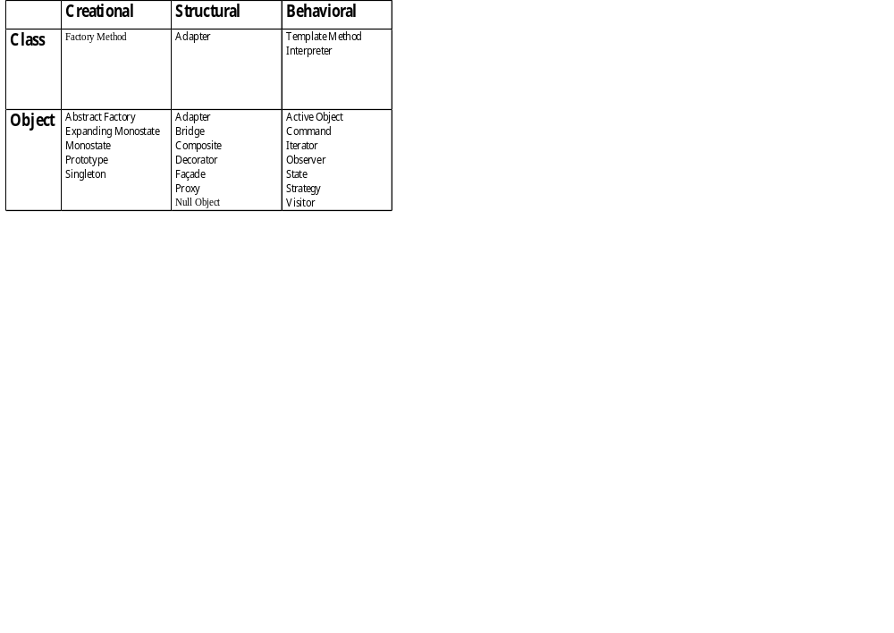
The Pattern Catalog
Purpose
  Creational: concerned with object creation
  Structural: concerned with composition of classes or objects
  Behavioral: concerned with ways classes or objects interact
Scope
  Class: relationships between classes and derived classes; static
  Object: relationships between objects; dynamic

Slide 40
Pattern Forms
A way of documenting patterns
  They are, among other things, a literary form
  You don’t reuse code
There are a number of them
  Alexanderian, Coplien, Gang of Four
We’ll use:
  Name, Problem, Intent, Context, Solution

Slide 41
A Few Words about Problems
Not a section in the GoF Patterns
  Because the GoF Patterns are the best-known, it means that many people don’t know about “Problem” as a section in patterns
Found in other forms
Why is it important?
We will add Problem statements to the GoF patterns during this course.

Slide 42
Documenting a Pattern
Intent:
  Describes the goal in succinct, high-level terms.
Context:
  Describes the problem, including the forces that cause the “dilemma”, and the negative consequences of not changing the design.
Solution:
  Describes the redesign that resolves the forces in a positive way. Include a sketch.

Slide 43
Strategy
Behavioral
Intent:
  Define a family of algorithms, encapsulate them, and make them interchangeable. Strategy lets algorithms vary independently from clients that use them.
Context:
  A class may need variants of an algorithm or implementation, configurable either at compile time or runtime. Or, you may have many related classes that differ only in their behavior. You want to minimize the amount of code that depends on changes in algorithm or implementation.
Solution:
  Define an interface for each algorithm family. Encapsulate each algorithm as an implementation of its interface. The abstraction that uses the algorithms keeps polymorphic references to their implementations.

Slide 44
Observer
Behavioral
Problem:
Intent:
Context:
Solution:
Notes:
Intent: Define a relationship between an abstraction (the “subject”) and its (possibly non-homogeneous) dependent objects (the “observers”) so that when the subject changes state, the observers are notified automatically.
Context: When objects are dependent on one or more other objects to do their work, a relationship needs to exist that keeps the subject and its observers synchronized. Since the dependency is one-way (from subject to observers), there needs to be a way for the subject to notify the observers of a change in state. Furthermore, there may be a need to add and remove observers at runtime. As always, a minimum of coupling is desired.
Solution: Provide methods that add, remove, and notify observers in an abstract base class that the subject extends (or if inheritance is not possible, provide the methods in a concrete class that the subjects holds by composition). The observers implement an interface with a callback method. The observers respond to the callback whenever the subject invokes it.

Slide 45
Prime Directive
Choose patterns by intent, not structure.
  The intent captures the solution to the problem; that’s what we are looking for
  The structure is how we do it
  Several patterns have similar structures, but the intents are different. That’s OK.

Slide 46
Principles Summary
Program to an interface, not an implementation
Strive for loosely-coupled designs between objects that interact.

